Slide 1

Biology for Engineers
Human organ systems and bio designs
Eye as a Camera system
Bionic Eye
The first implantation of a rudimentary version of the bionic eye was reported in 2012.
The patient, who suffered from profound vision loss as a result of retinitis pigmentosa, reported being able to see light but not being able to make distinctions within the environment.
The first model was created by the Australian company Bionic Vision Australia.
More-advanced technologies developed since then have been used in newer models implanted into patients whose vision was affected by retinitis pigmentosa.

Slide 2
The improved models have allowed patients glimpses of their environments, enabling them to make out abstract images, though their vision has not been fully regained.
Further research could raise the level of acuity that the bionic eye provides, and different materials, such as diamond, are being tested for their effectiveness in the implant.
Long-term effects of the implantation of a bionic eye remain unknown.

Slide 3
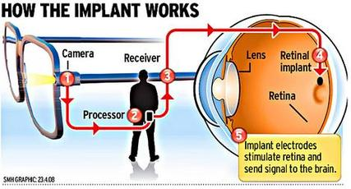

Slide 4
BIOLOGY FOR ENGINEERS
(21BE45)
Dr. Blessy B. Mathew,
Department of Biotechnology,
Dayananda Sagar College of Engineering,
Bangalore-11.
blessy-bt@dayanandasagar.edu

Slide 5
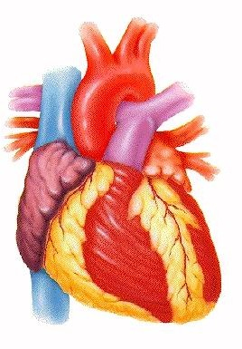
HUMAN ORGAN SYSTEMS AND BIO DESIGNS - 1
Heart: as a pumping system

Slide 6
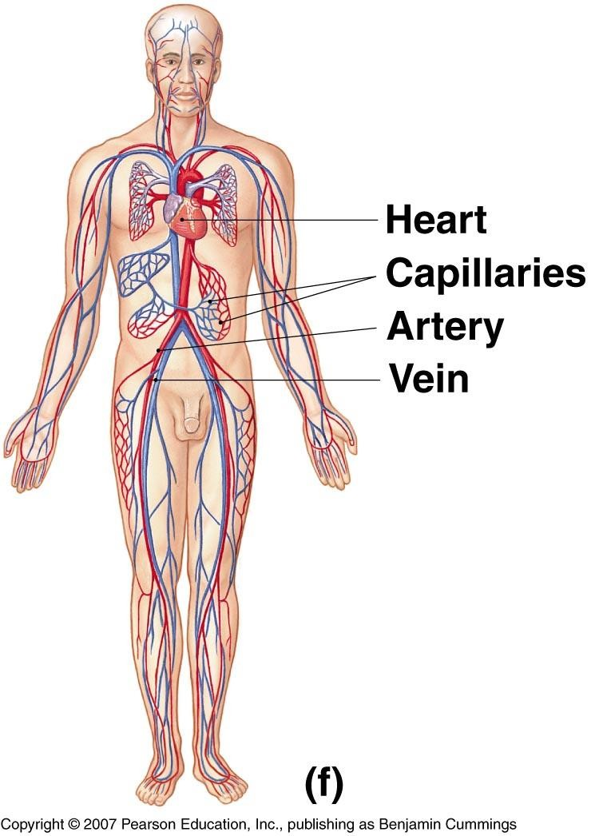
INTRODUCTION
The cardiovascular system is transport system of body
It comprises blood, heart and blood vessels.
The system supplies nutrients to and remove waste products from various tissue of body.
The conveying media is liquid in form of blood which flows in close tubular system.
Figure 1-2(f)

Slide 7
FUNCTION OF CARDIOVASCULAR SYSTEM
 Transport nutrients, hormones
 Remove waste products
 Gaseous exchange
 Immunity
Blood vessels transport blood
Carries oxygen and carbon dioxide
Also carries nutrients and wastes
 Heart pumps blood through blood vessels

Slide 8
COMPONENTS OF CARDIOVASCULAR SYSTEM
BLOOD
HEART
BLOOD VESSELS

Slide 9
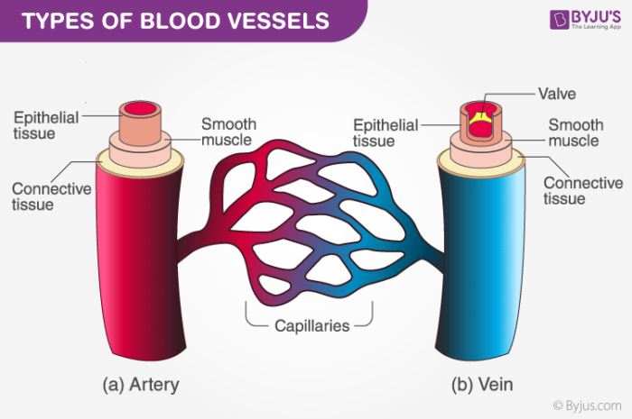
BLOOD VESSELS
Blood Vessels -A closed network of tubes
⮚
⮚
⮚
Arteries Capillaries Veins
Blood is the body’s fluid connective tissue, and it forms a vital part of the human circulatory system.
Its main function is to circulate nutrients, hormones, minerals and other essential components to different parts of the body.
Blood flows through a specified set of pathways called blood vessels. The organ which is involved in pumping blood to different body parts is the heart.
Blood cells, blood plasma, proteins, and other mineral components (such as sodium, potassium and calcium) constitute human blood.

Slide 10
BLOOD VESSELS
-Arteries(Distributing channel)
Thick walled tubes
Elastic Fibers
Circular Smooth Muscle
–
–Veins (draining channel)

Slide 11
HEART
Heart is a four chambered, hollow muscular organ approximately the size of your fist
Location:
Superior surface of diaphragm
Left of the midline
Anterior to the vertebral column, posterior to the sternum
6

Slide 12
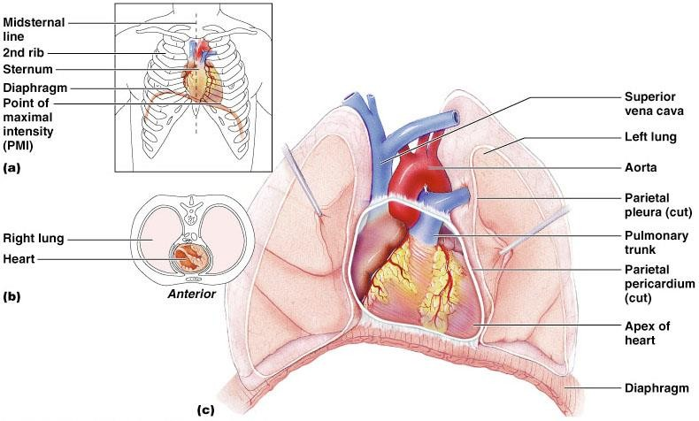
HEART
Figure ₇18.1

Slide 13
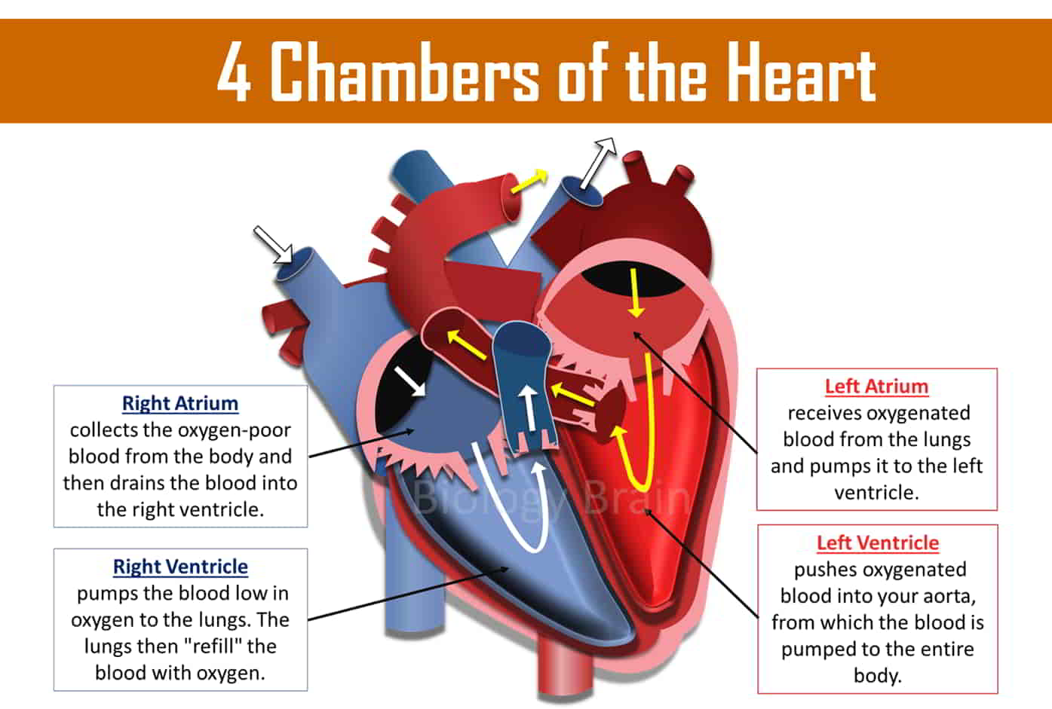

Slide 14
FUNCTIONS OF THE HEART
Generating blood pressure
Ensuring one-way blood flow
Heart valves ensure one-way flow
Regulating blood supply
Ensure supply of oxygenated blood to every cells of the body

Slide 15
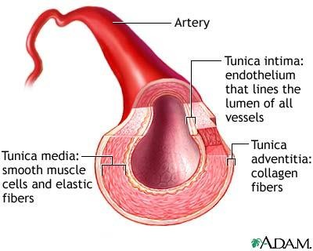
ARTERIES
Blood vessels that carry blood away from the heart are called arteries.
They are the thickest blood vessels and they carry blood high in oxygen known as oxygenated blood (oxygen rich blood).

Slide 16
ARTERIES
Accompanied by vein and nerves
Lumen is small
No valves
Repeated branching
Elastic- e.g. (Aorta & its Major branches)
Muscular -e.g.(Renal, Testicular, Radial, Tibial etc.)

Slide 17
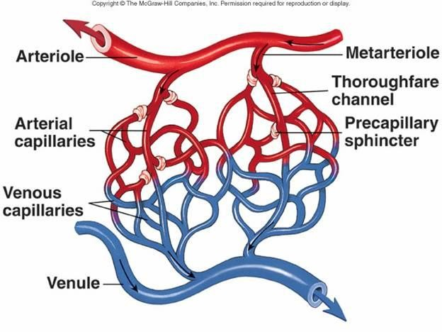
CAPILLARIES (5-8 micron)
The smallest blood vessels
are capillaries and they connect the arteries and veins.
This is where exchange
of gases occurs

Slide 18
VEINS
Blood vessels that carry blood back to the heart are called veins.
They carry blood that is high in carbon dioxide known as deoxygenated blood (oxygen poor blood).

Slide 19
VEINS
Thin Walled
Large irregular lumen
Have valves
Dead space around
Types:
Large Medium Small

Slide 20
CIRCULATION
–Coronary circulation – the circulation of blood within the heart.
–Pulmonary circulation – the flow of blood between the heart and lungs.
–Systemic circulation – the flow of blood between the heart and the cells of the body.
–Portal circulation - the flow of blood between tow set of capillaries before draining in systemic veins.

Slide 21
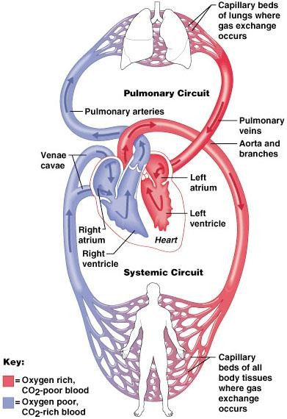
SYSTEMIC AND PULMONARY CIRCULATION
Pulmonary circulation
The flow of blood between the heart and lungs.
Systemic circulation
The flow of blood
heart
between the
and the cells of the body.
Figure₂₆18.5

Slide 22
Electrical Signaling in Heart
An electrical stimulus is generated by the sinus node also called SA node.
Sinus node is a small mass of specialized tissue located in the atria ( right upper chamber) of the heart.
The SA nod initiates the action potential. The gradual rise in action potential is known as pacemaker. ( this is natural pacemaker)
The sinus node generated electrical stimulus regularly for about 60 to 100 times per minute.
Followed by the activation of atria and electrical stimulus travel down via conduction path way which results in the contraction of the heart in order to pump out blood

Slide 23
Upper two chamber of the heart get stimulated first and followed by contract for brief period
The electrical impulse move from the sinus node to the atrioventricular node (also called AV node).
Electrical impulses are travel down the conduction pathway via the bundle of His into the ventricles.
The bundle of His divides into right and left pathways, called bundle branches in order to stimulate the right and left ventricles.
Following the delay, the impulse travels through the atrioventricular bundle and bundle branches to the Purkinje fibers, and also reaches the right papillary muscle via the moderator band.
The impulse spreads to the contractile fibers of the ventricle and finally Ventricular contraction begins.

Slide 24
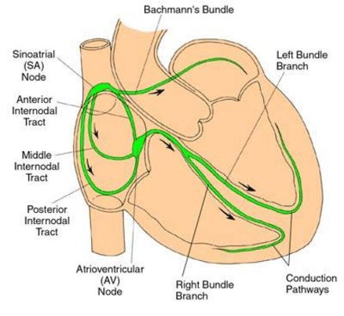
Electrical Signaling in Heart

Slide 25
Electrocardiogram (ECG/EKG)
Electrocadiogram represents finding of electrical activity of the heart.
Electrocardiography is the process of producing an electrocardiogram (ECG or EKG).
It is a graph of voltage versus time of the electrical activity of the heart using electrodes placed on the skin.
These electrodes detect the small electrical changes that are a consequence of cardiac muscle depolarization followed by repolarization during each cardiac cycle (heartbeat).
Changes in the normal ECG pattern occur in numerous cardiac abnormalities, including cardiac rhythm disturbances (such as atrial fibrillation and ventricular tachycardia), inadequate coronary artery blood flow (such as myocardial ischemia and myocardial infarction), and electrolyte disturbances (such as hypokalemia and hyperkalemia).

The action potential includes a depolarization (activation) followed by a repolarization (recovery).
Various phases of ECG and action potential:
Resting , upstroke , early repolarization, plateau , and final repolarization are the 5 phases of the action potential.

Slide 26
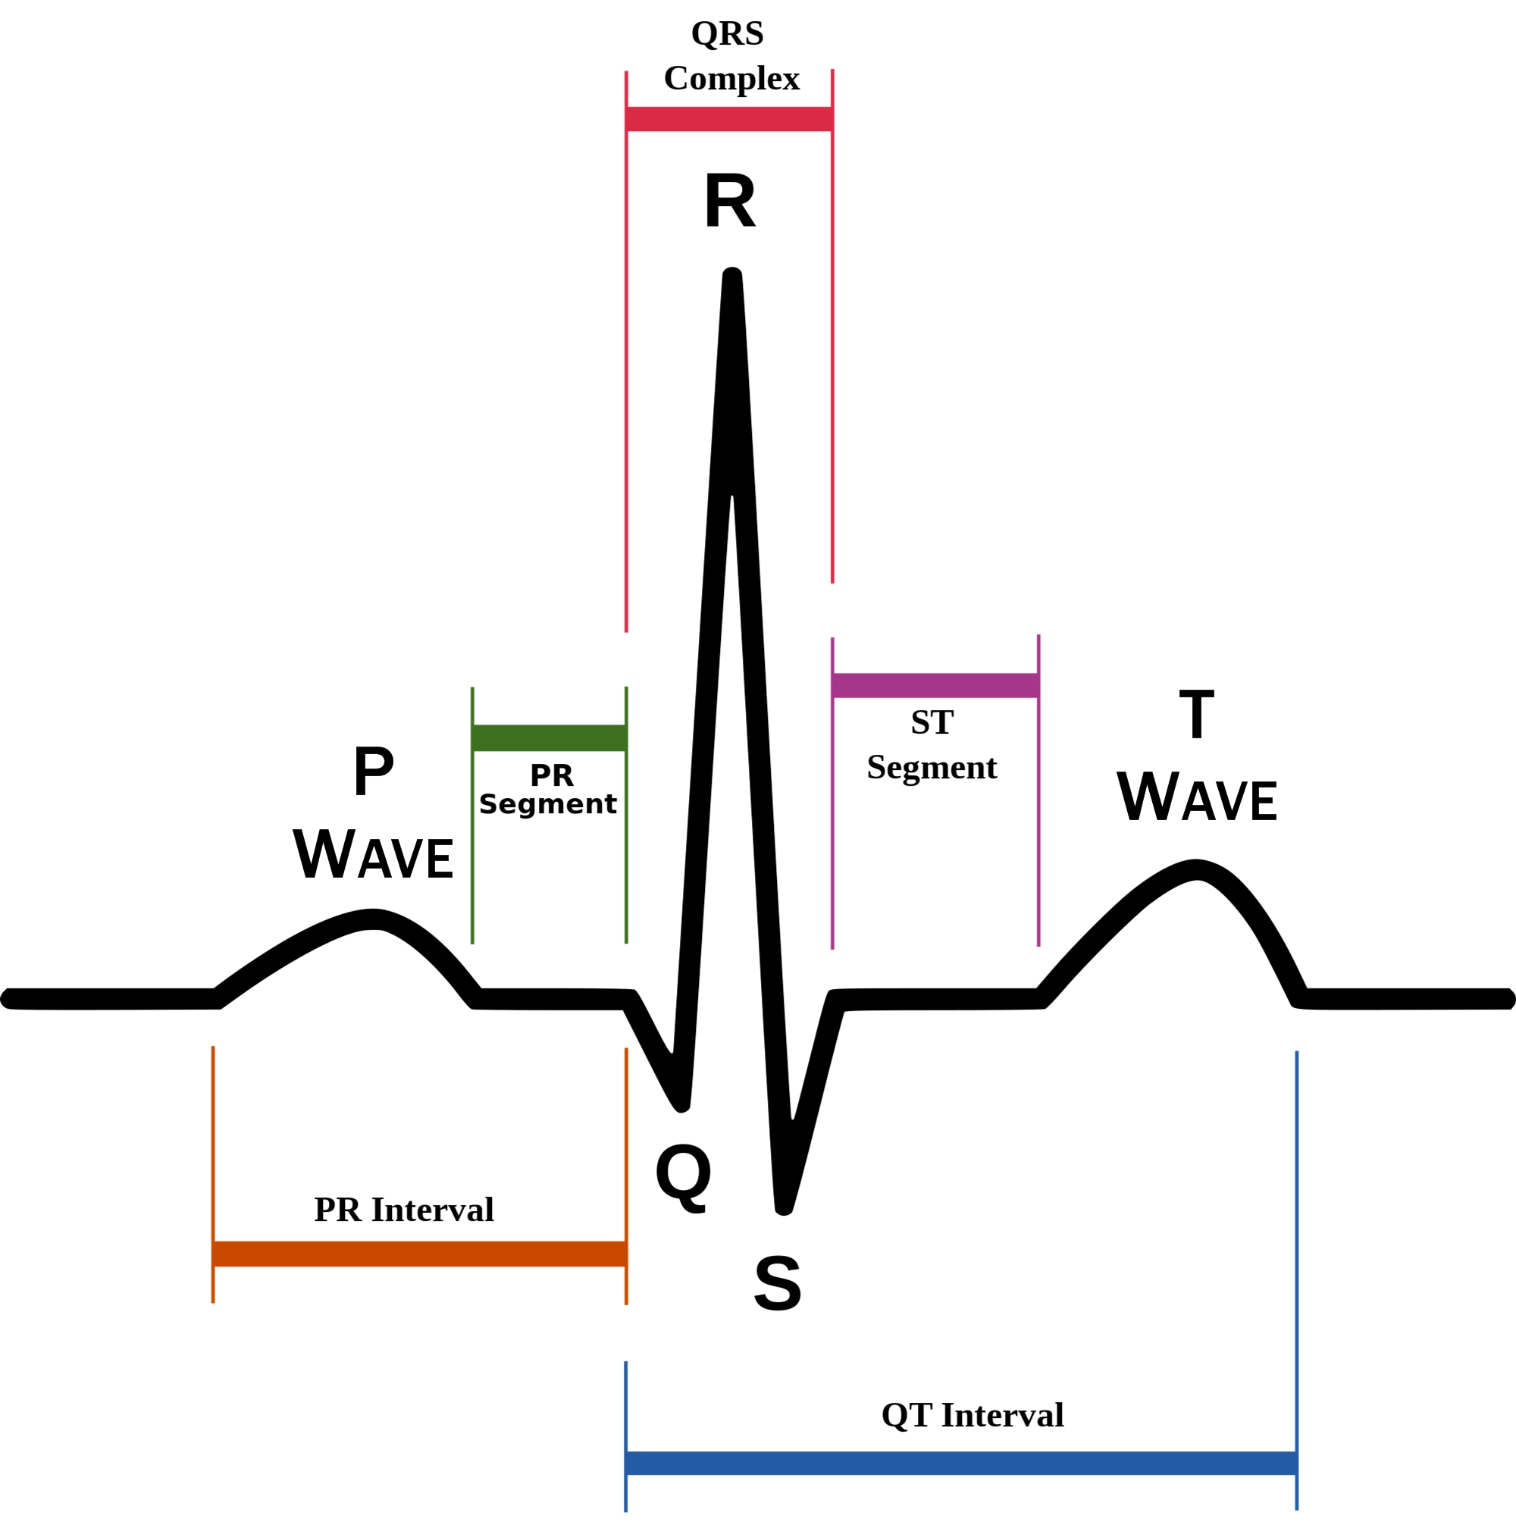

Slide 27
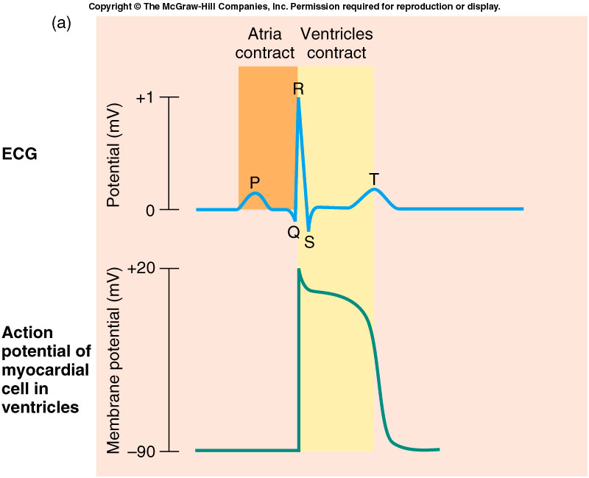
SA node
Atrial muscles
AV node
Bundle of HIS and branches
Purkinje fibers
Ventricular muscles
Each time the sinus node (SA node) generates a new electrical impulse; that impulse spreads out through the heart's upper chambers, called the right atrium and the left atrium
13-60

Slide 28
ECG Leads
Leads are electrodes which measure the difference in electrical potential.
They can be of two types:
1. Two different points on the body (bipolar leads)
2. One point on the body and a zero electrical potential.
The standard EKG has 12 leads:
3 Standard Limb Leads
3 Augmented Limb Leads
6 Precordial Leads

Slide 29
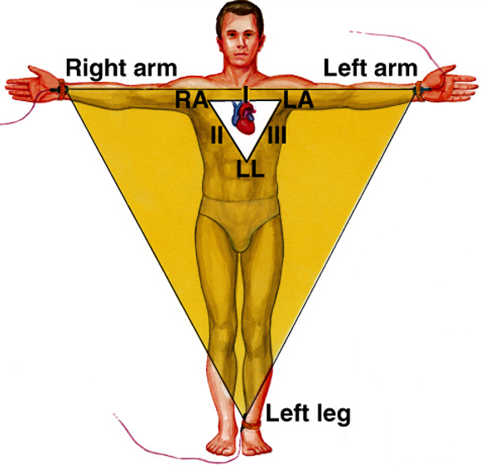
Types of ECG Recordings
Bipolar leads record voltage between electrodes placed on wrists & legs (right leg is ground)
Lead I records between right arm & left arm
Lead II: right arm & left leg
Lead III: left arm & left leg
13-61

Slide 30
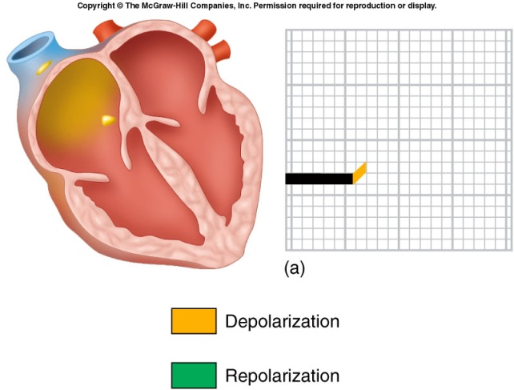
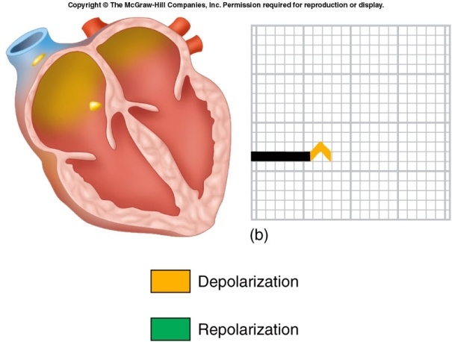
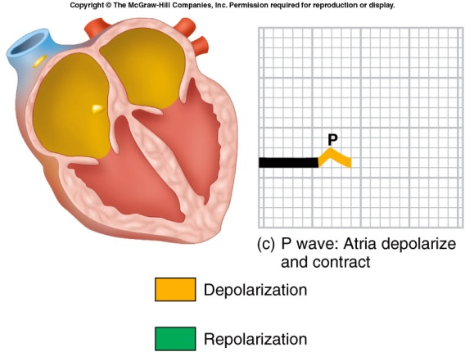
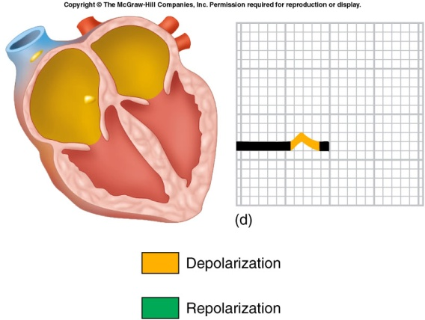
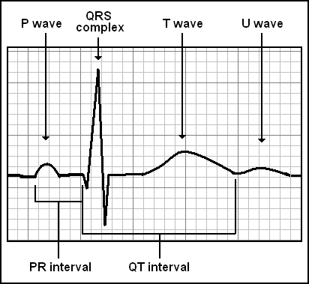
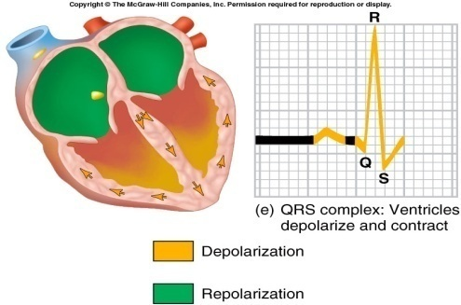
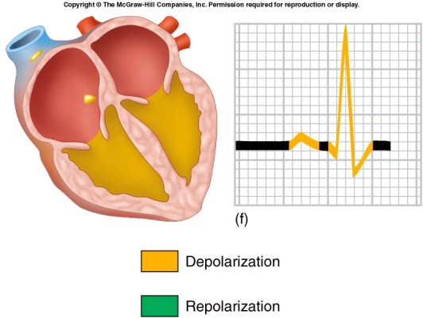
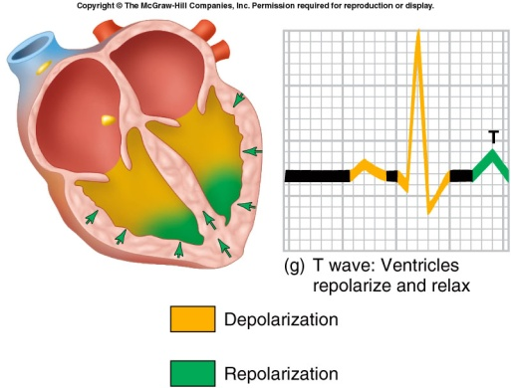
3 distinct waves are produced during cardiac cycle
P wave caused by atrial depolarization
QRS complex caused by ventricular depolarization
T wave results from ventricular repolarization

Slide 31
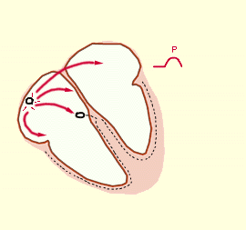
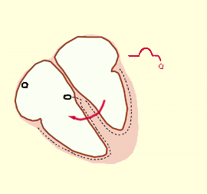
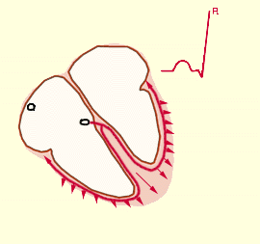
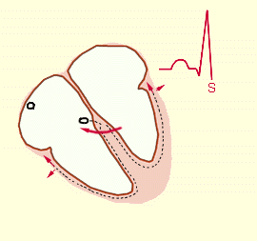
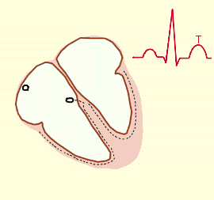

Slide 32
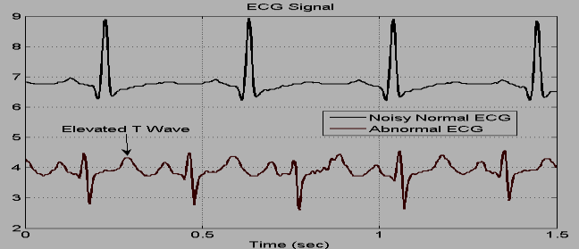

Slide 33
HEART RELATED ISSUES
Coronary Artery Disease (CAD)
CAD is the most common heart problem. With CAD, you may get blockages in your coronary arteries -- the vessels that supply blood to your heart. That can lead to a decrease in the flow of blood to your heart muscle, keeping it from getting the oxygen it needs.
Heart Arrhythmias
When you have an arrhythmia, your heart has an irregular beating pattern. Serious arrhythmias often develop from other heart problems but may also happen on their own.
Heart Failure
With heart failure, your heart doesn't pump blood as well as it should to meet your body's needs.
Heart Valve Disease
Your heart has four valves that open and close to direct blood flow between your heart's four chambers, the lungs, and blood vessels. An abnormality could make it hard for a valve to open and close the right way.

Slide 34
Reason for blood vessels blockages
The reason for blockages of arteries is due to the deposition of fat,. cholesterol .the gradual build of these are called plaques.
In addition clotting of blood within arteries can block blood supply to the heart.
The bursting of plaques can lead to blood clots and interfere in blood flow.
If the coronary arteries are blocked, the heart muscle beyond the blockage doesn’t get oxygen. That part of the heart muscle dies.
If the muscle dies It may result in myocardial infarction or commonly called heart attack.
Chest pain, or angina, may also occur when the heart muscle does not receive enough blood

Slide 35
DEFIBRILATION
Defibrillation was invented in 1899 by Prevost and Batelli, two Italian physiologists.
Defibrillation is a process in which an electronic device sends an electric shock to the heart to prevent irregular heartbeat, and restore the normal heart rhythm.
Defibrillation is a common treatment for life threatening cardiac dysrhythmias, ventricular fibrillation, and pulse less ventricular tachycardia.
Principle: Energy storage capacitor is charged at relatively low rate from AC line. Energy stored in capacitor is then delivered at a relatively rapid rate to chest of the patient. It involves the discharge of capacitor energy through the patient’s own resistance.
Rate (60 to 100 beats per minute)
Rhythm (Proper beating of heart) Lack of it leads to: Arrhythmia, Flutter
Sound (Lubb-Dubb)

Slide 36
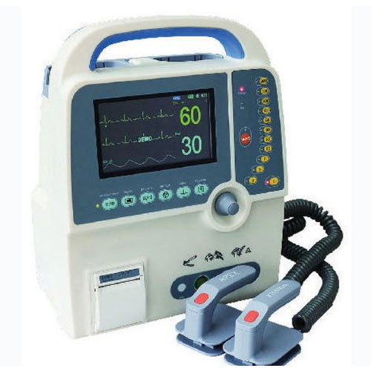
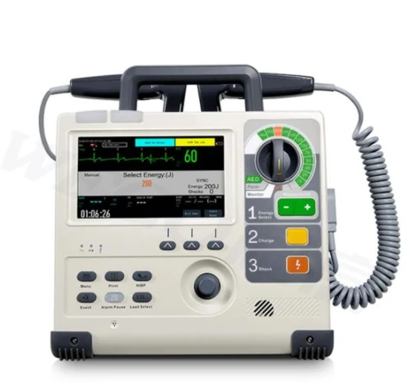

Slide 37
DEFIBRILLATORS
Types of Defibrillator electrodes:-
Spoon shaped electrode • Applied directly to the heart.
b) Paddle type electrode • Applied against the chest wall
c) Pad type electrode

Slide 38
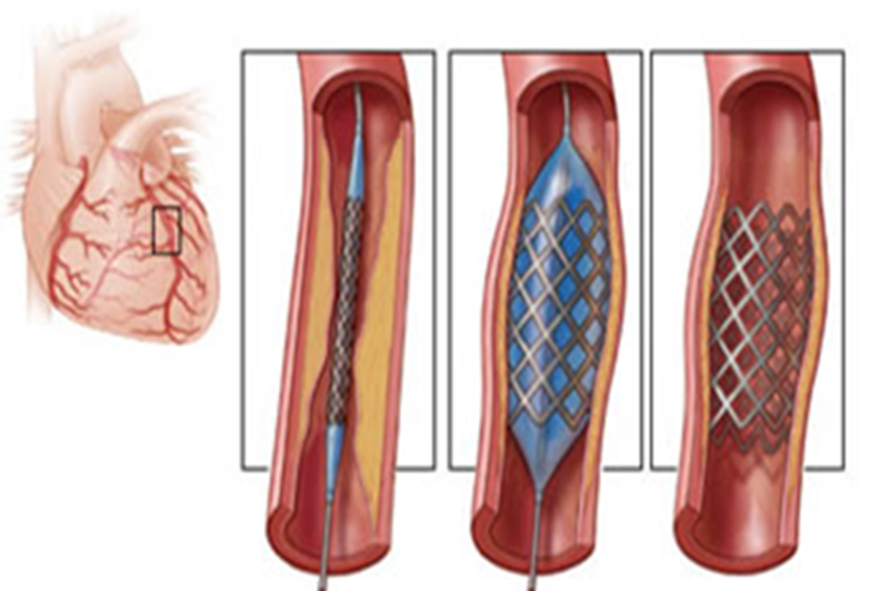
STENT
A stent is a small metal or plastic tube that has a mesh like pattern. Introduced during or after angioplasty.
It is placed in blocked or narrowed arteries that are obstructing blood flow.
The stent then keeps the artery open which allows the blood to flow unrestricted.
A stent is a small metal or plastic tube that has a mesh like pattern. It is placed in blocked or narrowed arteries that are obstructing blood flow.
The stent then keeps the artery open which allows the blood to flow unrestricted. While stents are commonly associated with arteries, they are also used in other passageways that may be affected by blockages.
For example, a ureteral stent may be used to
allow unobstructed urine flow especially in the
case of a compromised ureter.
A small, metal mesh tube that expands inside a
coronary artery.

Slide 39


Slide 40
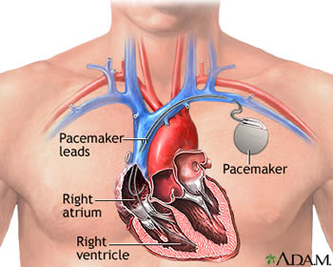
PACEMAKER
A pacemaker is a type of medical device which uses electrical impulses that is inserted under the skin either in the chest or abdomen.
It uses these electrical impulses to contract the heart muscles and thus helps regulate the beating of the heart.
It uses electrical impulses that is inserted under the skin either in the chest or abdomen.
People who suffer from irregular heartbeats or from arrhythmia are generally recommended to get a pacemaker, as it helps maintain an adequate heart rate, when the heart's natural pacemaker is not fast enough, or because there is a block in the heart's electrical conduction system.

Slide 41
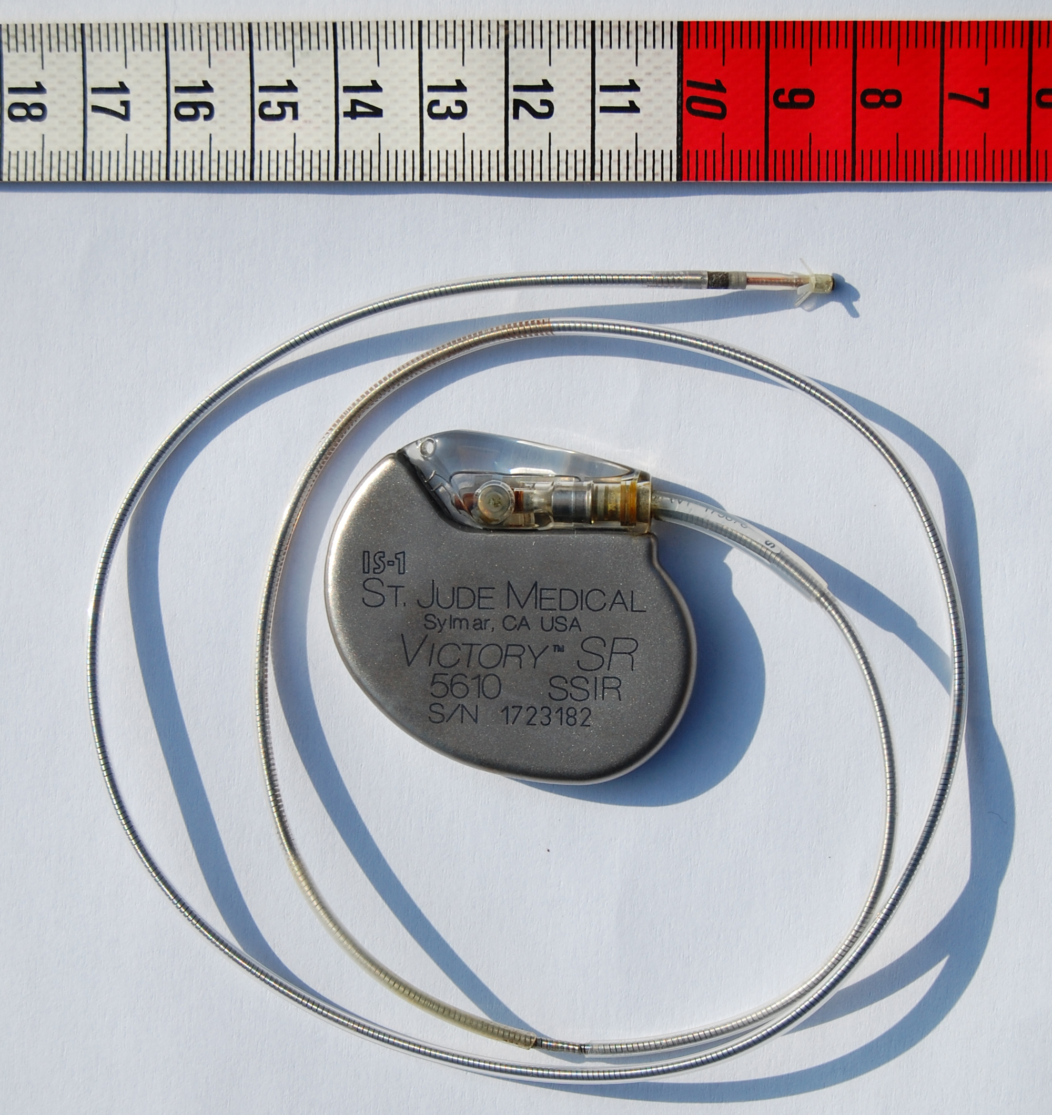


Slide 42
How pacemaker operates
Tiny battery operated computer is implanted below the skin in chest .
The wire or electrode that are implanted is connected to computer
The pacemaker senses the variation in heart rhythm.
If it senses heart beat is too slow or missed a beat, the it will send an electric impulse to stimulate the heart to restore normal heart rate

Slide 43
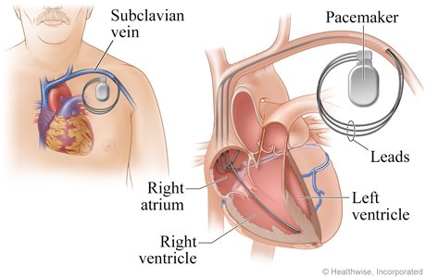
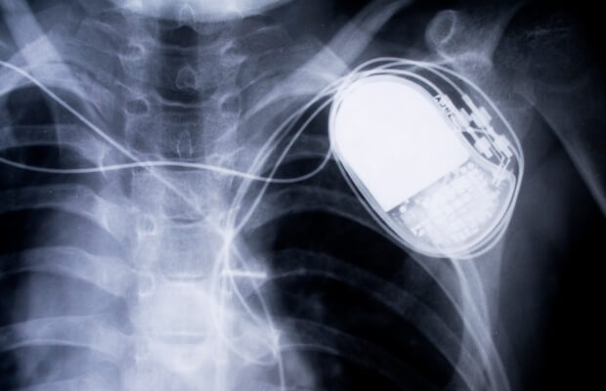

Slide 44
Types of pacemaker
Single chamber pacemaker
Dual chamber pacemaker
Bi- ventricular pacemaker

